Slide 1
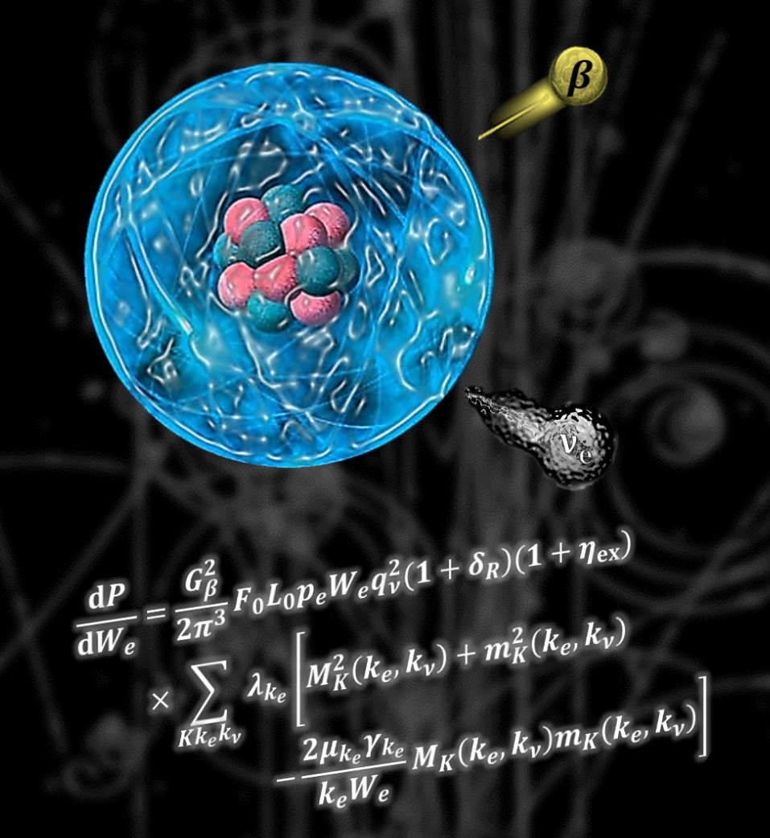


BetaShape
Manual
X. Mougeot, CEA-LNHB (France)
Version 2.3
September 2023

Slide 2
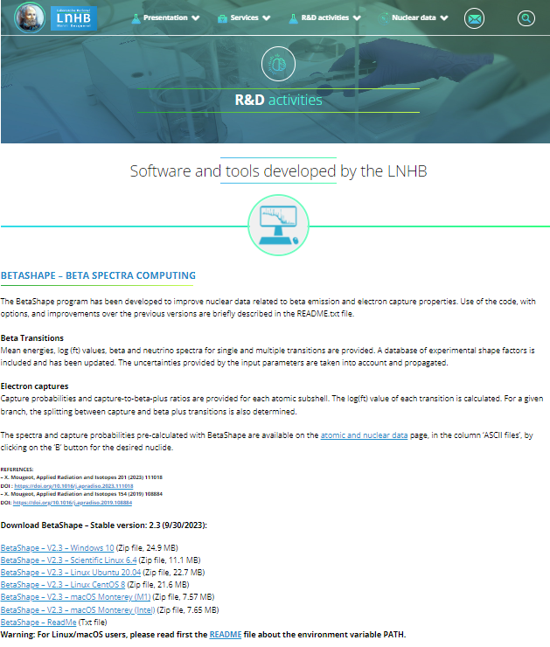

Getting the code: LNHB website
Executables of the latest version of the code are available at:
http://www.lnhb.fr/rd-activities/spectrum-processing-software/
Latest released version is 2.3.
Previous versions are available on request but not recommended.
Download the executables for your OS.
Unzip.
Open the main directory.

Slide 3
Contents
Main program is ‘betashape’, which calls the others programs. Windows version contains ‘cmd.exe’ for opening a terminal.
‘External_files’ directory contains important information required by the code:
Current version.
Tabulated parameters to speed-up the atomic wave function calculation.
Tabulated parameters of atomic screening and exchange corrections in beta decays.
Recommended Q-value database from Atomic Mass Evaluation 2020.
Database of experimental shape factors (beta spectra) and related publications.
Benchmark to test the code on your computer:
‘bench’ directory contains executed files for ⁴⁰K, ¹³⁰Cs, ¹³³I and ²⁰⁵Pb decays.
‘mybench’ script performs the calculations and calls ‘mydiff’ script to compare each file, line by line.
Readme file contains basic information:
How to use the code: path, options, example of command line.
Benchmark calculations.
Description of CSV files.
History of changes since the first version.

Slide 4

Input file
ENSDF files are taken as standard input of the BetaShape code.
Extraction of relevant information for all beta and electron capture transitions in the decay scheme.
Determination of the parameters required for the calculation, e.g. transition energy, transition nature, transition intensity.
Uncertainties on input parameters are propagated.
Several decay schemes or even a mass chain can be given at once.
Some instabilities have been observed and perfect execution is not guaranteed.
Current solution is to write down a short script that splits the input file in different sub-files, which are next executed independently. Eventually, the updated sub-ENSDF-files can be gathered in a single updated ENSDF file.
This solution works very well when going through the entire ENSDF database (log-ft review).
Download the ENSDF files of ¹³⁸La decay
IAEA Livechart: https://www-nds.iaea.org/relnsd/vcharthtml/VChartHTML.html
NNDC NuDat: https://www.nndc.bnl.gov/nudat3/
DDEP: http://www.lnhb.fr/nuclear-data/nuclear-data-table/

Slide 5
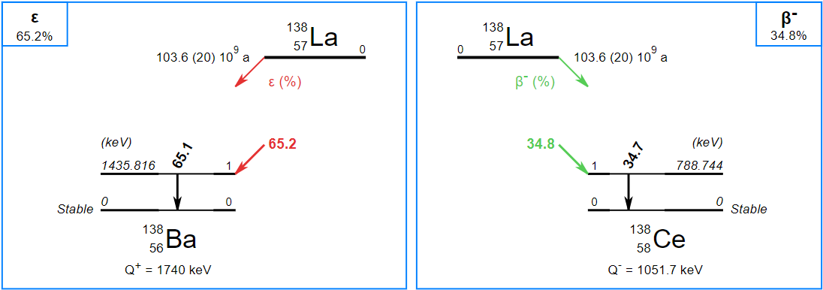
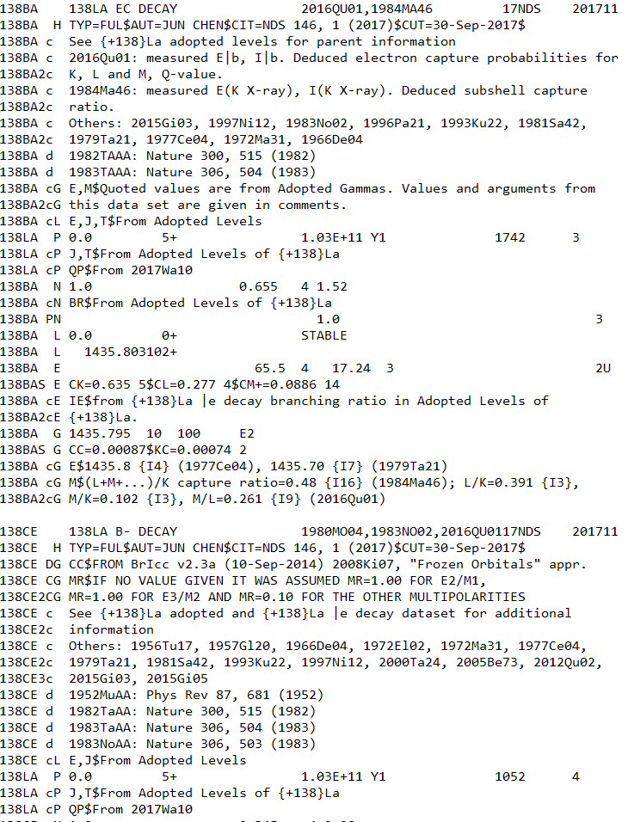

Running the code
‼ ¹³⁸La has two decay modes.
Open a terminal.
Run the code with default options
C:\...> betashape La138.txt
Note 1: Input file is a text file in ENSDF format, whatever the extension.
Note 2: Several programs are called during the global execution. Full rights (read, write, execute) are required in the BetaShape directory.
Look at the output files generated: .read, .trans., .rpt., .new in the BetaShape directory, and .bs in the created La138 sub-directory.

Slide 6
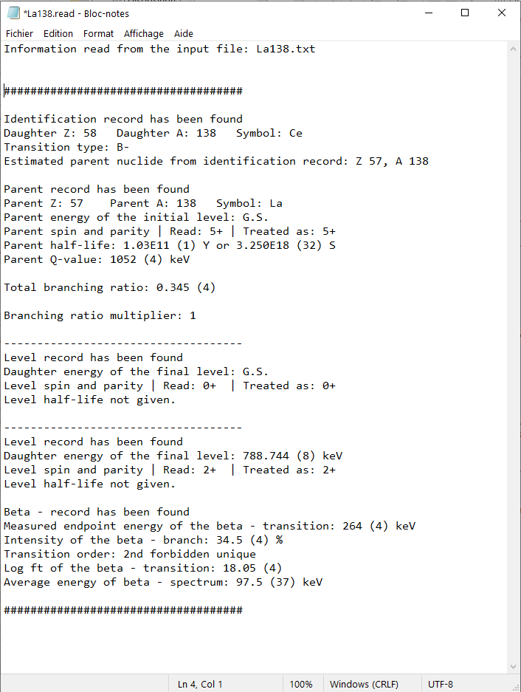
Output file .read

Slide 7
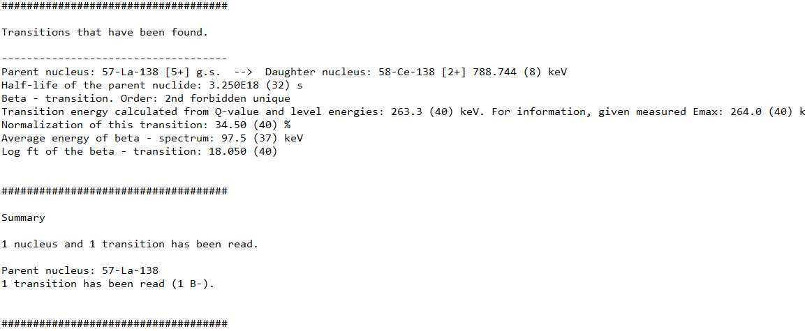
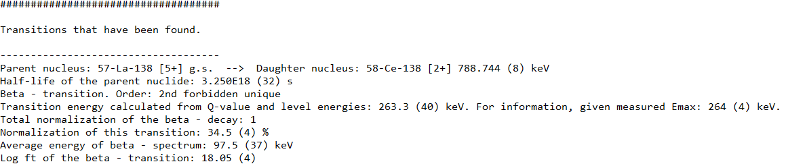
Output file .trans
Transition order (nature) determined from spins and parities of initial and final levels. If several given, treated as allowed.
Transition energy determined from Q-value and level energies, with propagation of uncertainties. Endpoint energy not used (ENSDF policy: given only if measured).

Slide 8
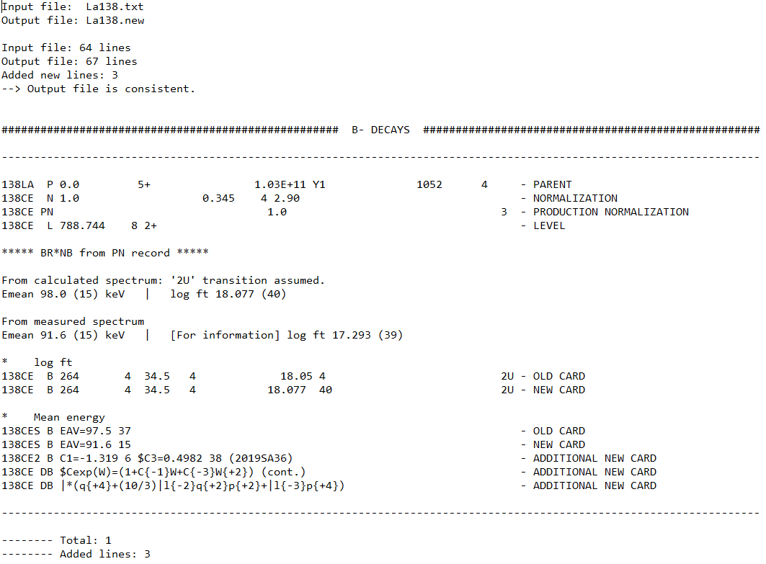
Output file .rpt
Report file in LogFT style. Summary of the results.
For each transition:
Cards that identify the transition.
Old card / New updated card. Can be Parent card if Q-value updated.
Additional information.
Results summarized as BetaShape runs: B- first, then EC and finally B+.
Brief summary of total transitions considered and number of added lines in the updated ENSDF file.

Slide 9
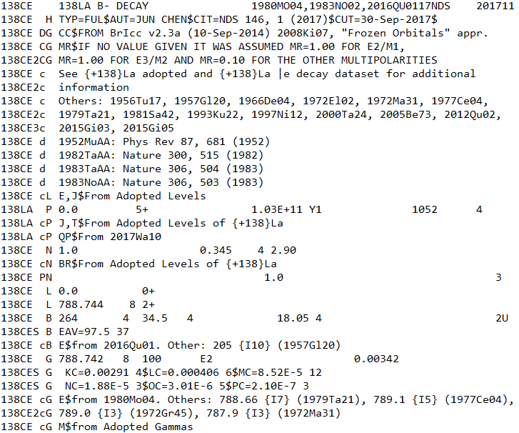
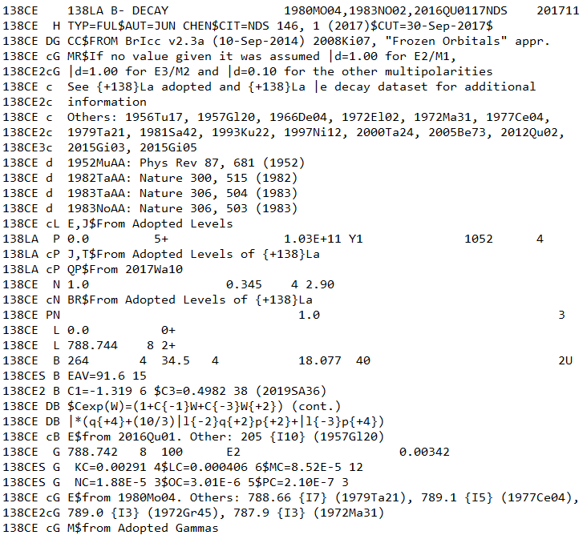
Output file .new
Input ENSDF file: La138.txt
Updated ENSDF file: La138.new

Slide 10
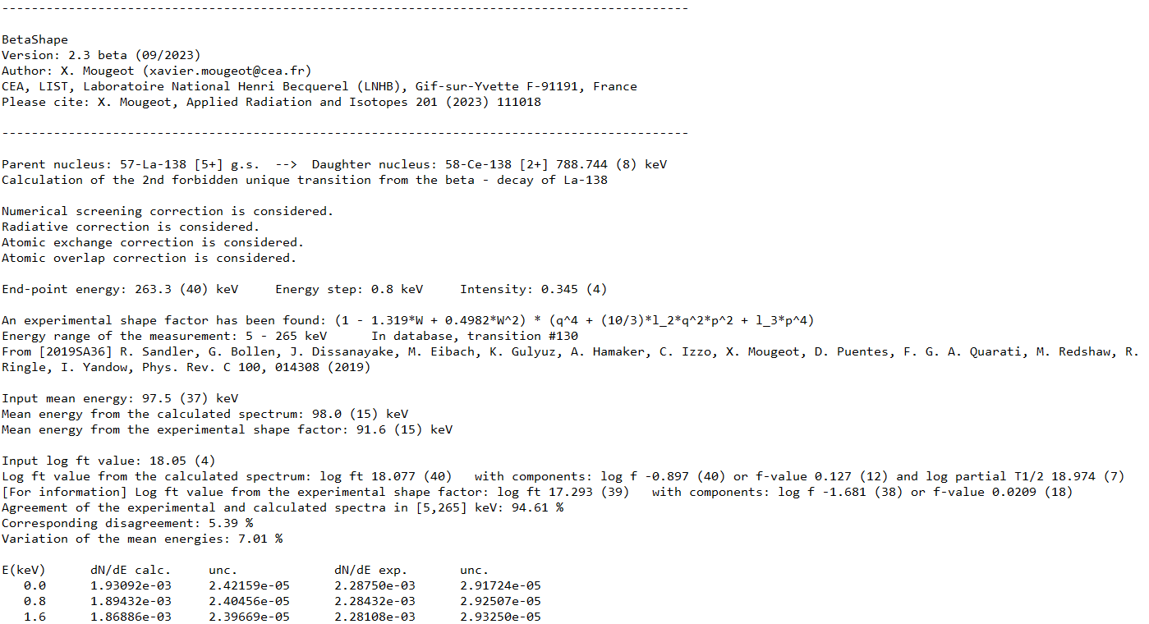
Output file .bs – single B transition
Transition parameters and options used in calculation
Experimental shape factor
Mean energies, log ft values, analysis parameters
Beta spectra
Option: antineutrino spectra

Slide 11
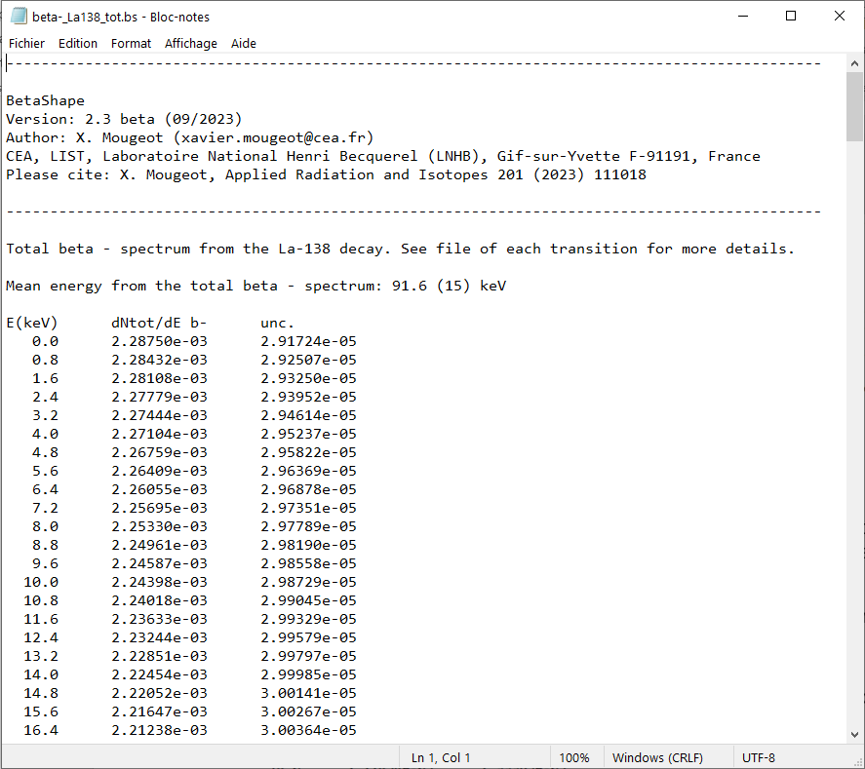
Output file .bs – total B spectrum
Total beta spectrum of the decay is built from single transition spectra normalized to the branching ratios. Experimental spectrum is preferred if any.
Total mean energy of beta emitted particles is determined.
Uncertainties are propagated.
‼ Energy step can be not constant in order to keep more information at low energy even with large endpoint energy.
Optional: (anti)neutrino spectrum.

Slide 12
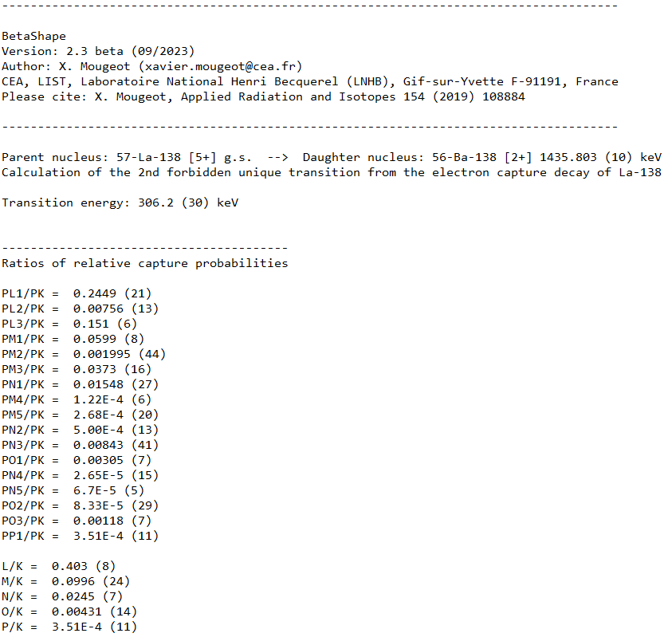
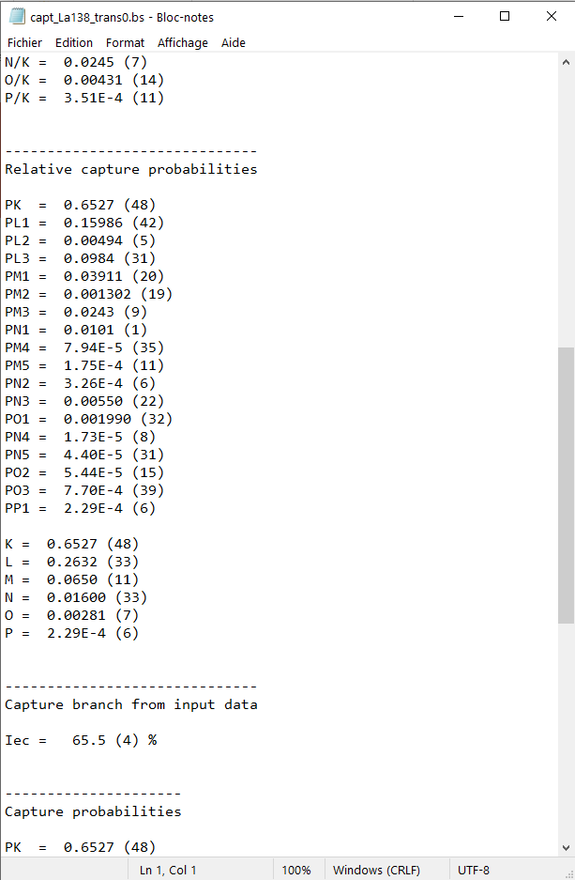
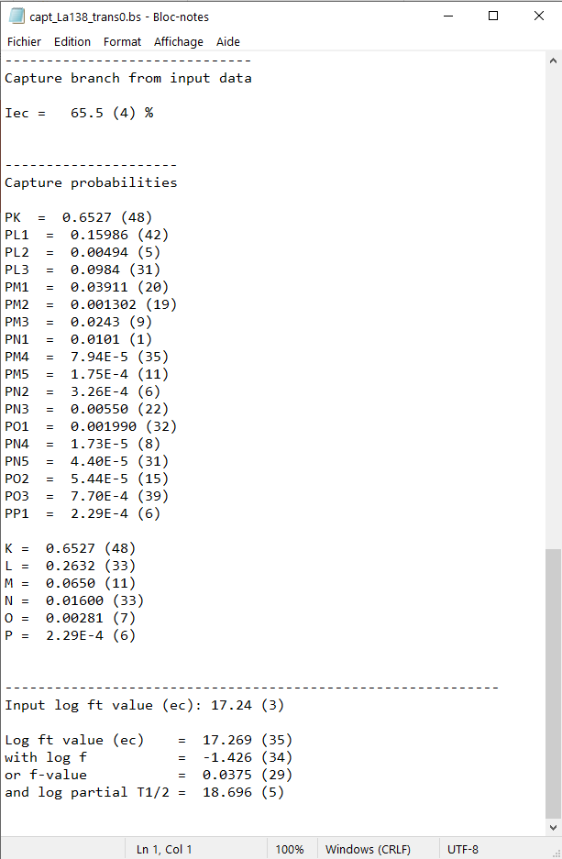
Output file .bs – single EC transition
Not identical if B+ competes
Detailed information for subshells.
Combined for shells.
If B+ competes:
Splitting of the branch also given. Intensities updated.
EC/B+ ratios also given for subshells, shells and total.

Slide 13
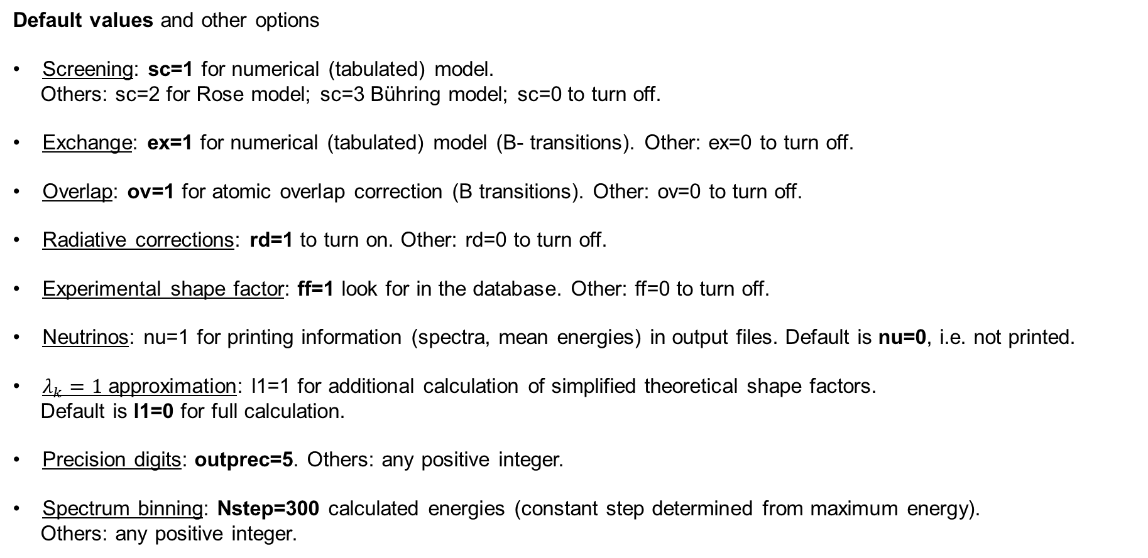
Options (1)
Default values and other options
Screening: sc=1 for numerical (tabulated) model.
Others: sc=2 for Rose model; sc=3 Bühring model; sc=0 to turn off.
Exchange: ex=1 for numerical (tabulated) model (B- transitions). Other: ex=0 to turn off.
Overlap: ov=1 for atomic overlap correction (B transitions). Other: ov=0 to turn off.
Radiative corrections: rd=1 to turn on. Other: rd=0 to turn off.
Experimental shape factor: ff=1 look for in the database. Other: ff=0 to turn off.
Neutrinos: nu=1 for printing information (spectra, mean energies) in output files. Default is nu=0, i.e. not printed.
$λ_{k}=1$ approximation: l1=1 for additional calculation of simplified theoretical shape factors.
Default is l1=0 for full calculation.
Precision digits: outprec=5. Others: any positive integer.
Spectrum binning: Nstep=300 calculated energies (constant step determined from maximum energy).
Others: any positive integer.

Slide 14
Options (2)
Default values and other options
EC and B+ intensities: fixint=0 for calculating and updating the splitting of the branch between EC and B+.
Other: fixint=1 for keeping the intensities from the input file.
Spectrum energy step: myEstep=0. energy steps managed automatically.
Others: any positive number as constant energy step (in keV) for all calculated spectra. Additional output files.
Q-values: -qval for automatic update from AME2020 recommendations.
Default: turned off; Q-value from input file is kept.
Rounding limit of uncertainties: unc_digit=50. Other: any integer from 1 to 99.
Asymmetric uncertainties: -asym to turn on their treatment. Default: symmetric uncertainty treatment.
Saisinuc: -saisinuc for creating a specific formatted output file for the Microsoft Access database of DDEP evaluations. Default: turned off.
-csv for creating CSV files (separator is ', ') for B- and EC/B+ transitions. Default: turned off.
-csv_fr for creating CSV files in French version (separator is ‘ ; ‘). Default: turned off.

Slide 15
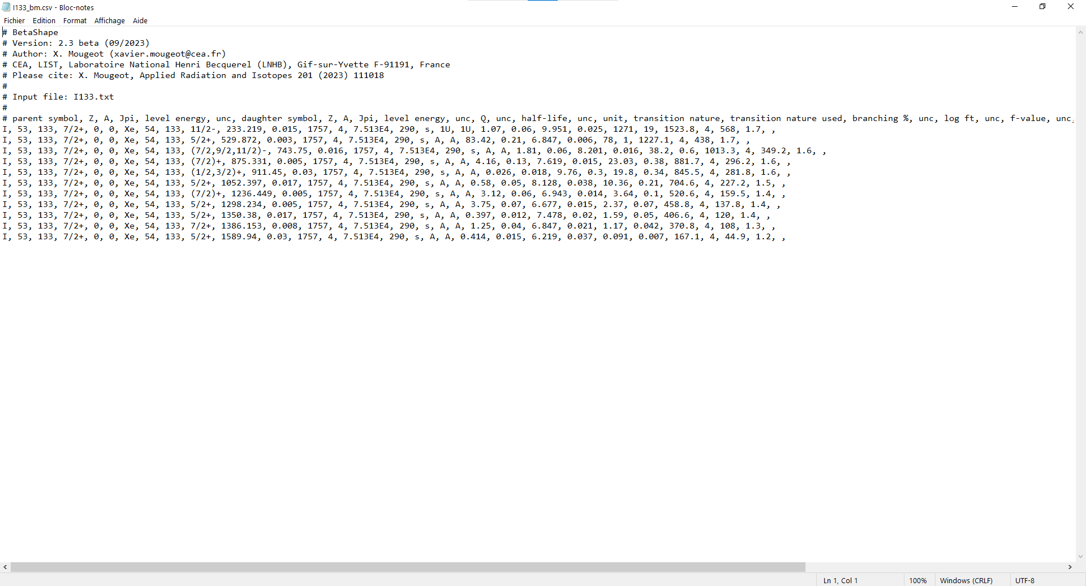
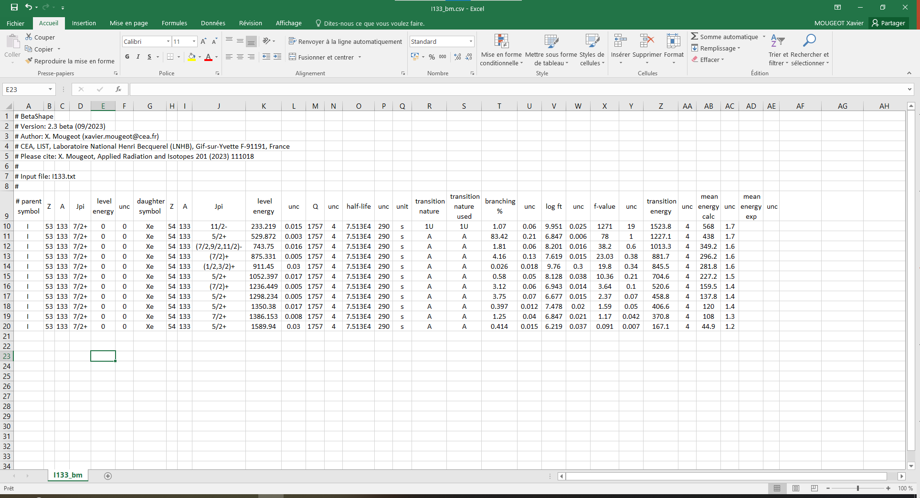
CSV file
Opened in text editor
Opened in Excel

Slide 16
Playing with the options
Try different possibilities varying the options.
Some examples:
I want neither screening nor radiative corrections.
C:\...> betashape La138.txt sc=0 rd=0
I want to update automatically the Q-value and create a CSV file.
C:\...> betashape La138.txt -qval -csv
I want the neutrino spectra and all spectra with 1 keV binning.
C:\...> betashape La138.txt nu=1 myEstep=1.
I have measured EC and B+ intensities. I trust them and I do not want an automatic update from theory.
C:\...> betashape Cs130.txt fixint=1

Slide 17
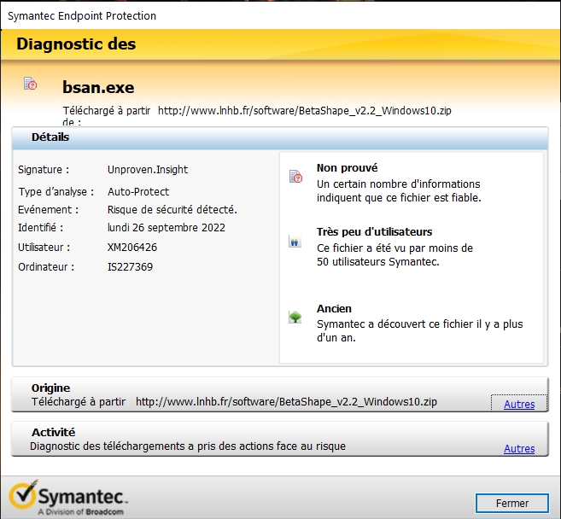
Possible antivirus problem
In Windows, such a message can append for each of the programs when run.
Programs are not recognized in the antivirus database and can be put in quarantine.
Declare the BetaShape directory and all the content as safe.
Release the programs from quarantine.
Administrator rights can be necessary.

Slide 18
If any other problem appears…
Check your rights in the BetaShape directory: read, write and execute are necessary.
Check the PATH: execution in local directory is required. See Readme file.
Move the input file and execute the code in the BetaShape directory.
90% of encountered cases come from an ENSDF file that does not respect the ENSDF format: e.g. file modified by hand or generated by a specific program.
Check the ENSDF file, e.g. running FMTCHK, FormatCheck or ConsistencyCheck.
Look at .read file: information that has been read.
Look at .trans file: deduced information on the transitions that are being calculated.
If message in console command: ‘Pb new file: La138.txt’
and in .rpt file: ‘--> !!!!! A problem occurs when writing the output file !!!!!’
Only a single blank line at the end of input file.
Remove any additional line. Should not change the results.
If problem unsolved or for any other problem: send me a message at xavier.mougeot@cea.fr

Slide 19
Thank you for attention.

